Slide 1
Discontinuity-Aware 2D Neural Fields
Yash Belhe - University of California San Diego Michael Gharbi, Matthew Fisher, Iliyan Georgiev - Adobe
Ravi Ramamoorthi, Tzu-Mao Li - University of California San Diego
Notes:
Hi, I’m Yash Belhe and I’m super excited to present our work on Discontinuity Aware 2D Neural Fields.
This is a presentation about a new image format that preserves discontinuities no matter how far you zoom into it.
This work is a joint collaboration between UCSD and Adobe, and I’m thankful to my mentors Michael, Matt, Iliyan and my advisors Ravi and Tzu-Mao for all the support.

Slide 2
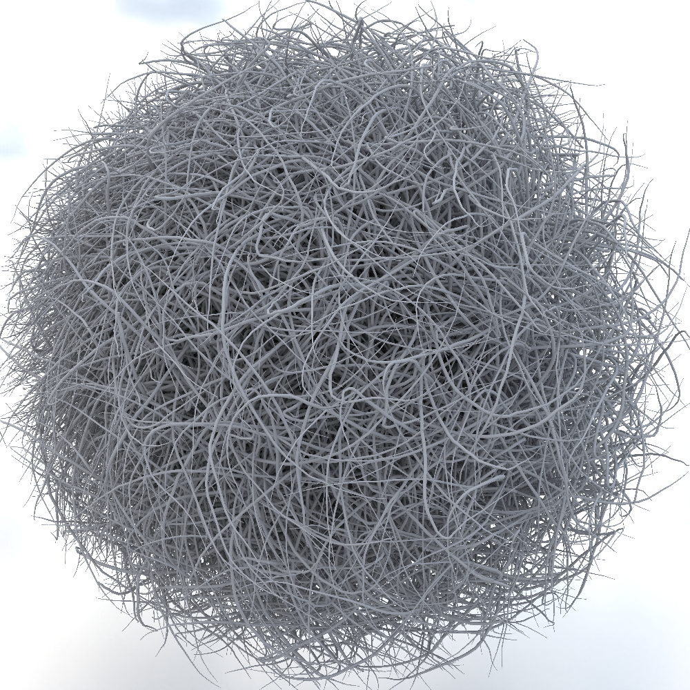
Path-tracing can produce arbitrarily high resolution images
Notes:
In graphics, there are several applications that can produce images at an arbitrarily high resolution.
Take for example, path-tracing.
It produces a raster image image by sampling an underlying continuous signal.
These raster images can have an arbitrarily high resolution depending upon the sampling rate we choose.
We want to build an image format for these images so we can render once and zoom into it arbitrarily after rendering.

Slide 3
Let’s re-render a 100x close-up here
Notes:
Let’s re render by zooming 100x into our image!

Slide 4
100x zoom — image has discontinuities!
Notes:
Zooming in, we notice that our image has discontinuities.
The discontinuities in this image are due to visibility changes.
They make the image look sharp.
We would like our image format to also have these discontinuities to make it look sharp.

Slide 5
Discontinuity locations are analytically known
Notes:
What’s more is that the location of these discontinuities are analytically known.

Slide 6
Most image formats do not use discontinuity information
Notes:
Most image formats don’t use this discontinuity information in any manner.
We’d like our image format to use this information to produce a discontinuous image.
Let’s briefly talk about what our contributions are in this work

Slide 7
Our contribution
Hybrid neural-mesh-based representation for images
Is optimizable
Can be rendered at any zoom scale in real time
Can preserve discontinuities that are given
Notes:
We introduce a hybrid neural-mesh-based representation for images that can be optimized to fit any target image.
It can also be re-rendered in real time at any zoom scale.
And crucially, it can preserve discontinuities in the target image that are provided as input.

Slide 8
Common image representations
Notes:
Before we look at our method, let’s check out some common image representations.

Slide 9
Raster images can represent complex signals
Notes:
Raster images represent complex signals.
Unfortunately, zooming in reveals a serious problem

Slide 10
… but details are limited by resolution
Notes:
What should have been a sharp discontinuity now looks like a jagged edge.
This is a fundamental limitation of the raster image format.
Storing pixel colors in a grid throws away rich information about discontinuity locations that are analytically known.
Thus, it’s not surprising that they can never represent discontinuities at all zoom levels.

Slide 11
Neural fields can compactly encode giga images!
InstantNGP: Muller 22
Martel 21: ACORN: Adaptive Coordinate Networks for Neural Representation Muller 22: Instant Neural Graphics Primitives with a Multiresolution Hash Encoding
Notes:
Recently neural fields, for example, instantngp have had great success at compactly encoding high fidelity signals.
The image on screen is the same as the earlier one, except this time it’s encoded by a neural field and requires only a fraction of the storage that the raster image required.
Neural fields promise infinite resolution since you can query them at any continuous coordinates.
So let’s zoom in 100x to see what happens.

Slide 12
… but they blur discontinuities
InstantNGP: Muller 22
Notes:
Unfortunately, neural fields also struggle at representing discontinuities — they simply blur over them.
Simply scaling up and increasing the parameter count of your favorite neural field approach won’t work here.
This is because they continuously map x,y coordinates to colors.
As a result, discontinuities will always appear to be smoothed over at some zoom level….
Let’s now take a look at why neural fields and in specific, feature fields which explicitly store features on a regular grid fail to represent discontinuities.

Slide 13
Neural fields are continuous by construction
Notes:
We start with a query point

Slide 14
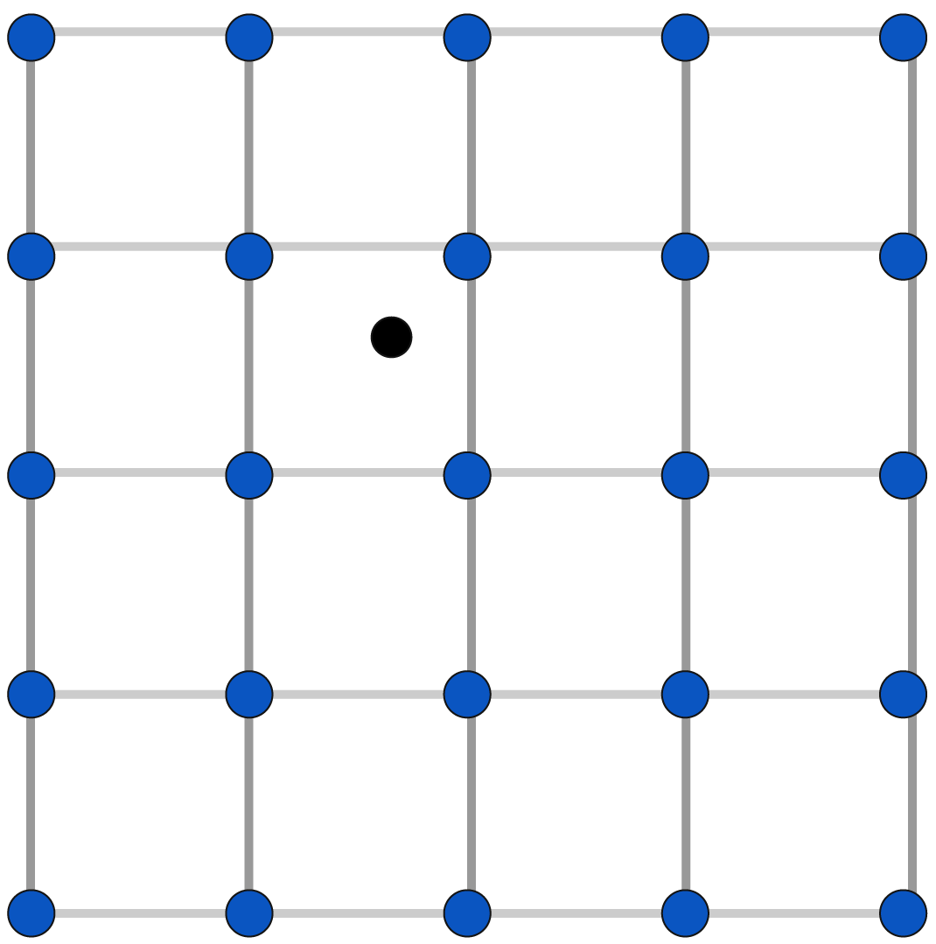
Neural fields are continuous by construction
Feature field
Notes:
Next, we find the grid cell that contains the query point

Slide 15
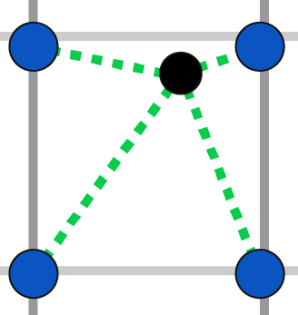
Neural fields are continuous by construction
Feature field
Bilinear interpolation
Notes:
Next, we bilinearly interpolate the features store at the corners of the grid cell.

Slide 16
Neural fields are continuous by construction
Feature field
Interpolated Feature
Bilinear interpolation
Notes:
This gives us the interpolated feature vector for the query point.

Slide 17
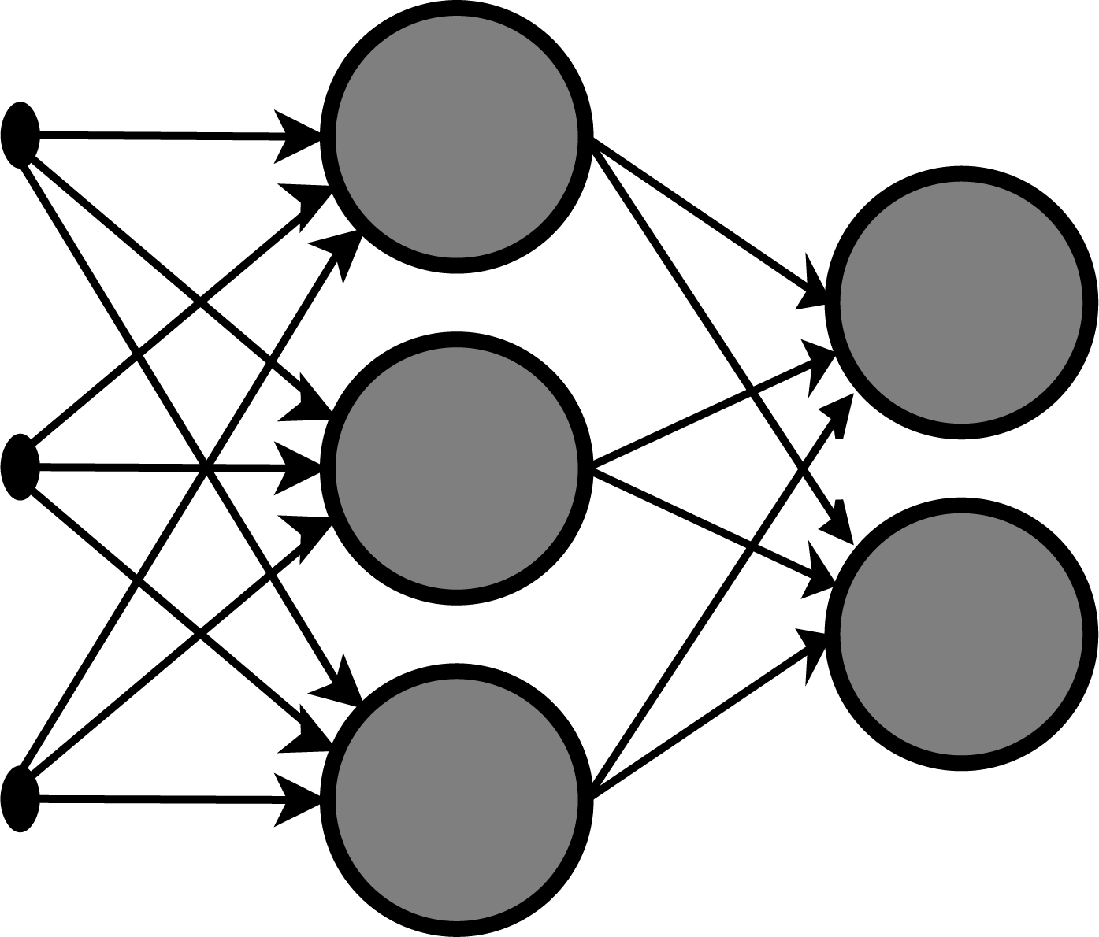
Neural fields are continuous by construction
Feature field
Interpolated Feature
MLP
Bilinear interpolation
Notes:
We decode this interpolated feature using an MLP

Slide 18
Neural fields are continuous by construction
Feature field
Interpolated Feature
MLP
Color
Bilinear interpolation
Notes:
And this gives us the color.

Slide 19
Neural fields are continuous by construction
Feature field
Interpolated Feature
MLP
Color
Bilinear interpolation
Notes:
Since all of the operations in this pipeline for example bilinear interpolation and neural network decoding are continuous, the final image produced by neural fields are also continuous by construction.
This is why neural fields blur over discontinuities present in a target signal.
The main appeal of neural fields is that they can be optimized to fit any target signal.
We’d like to preserve this property and also add the capability to represent sharp discontinuities.
For this we take inspiration from vector graphics.

Slide 20
Vector graphics analytically store discontinuity locations
Notes:
Because vector graphics analytically stores the discontinuity curves, the images appear sharp at all zoom levels.

Slide 21
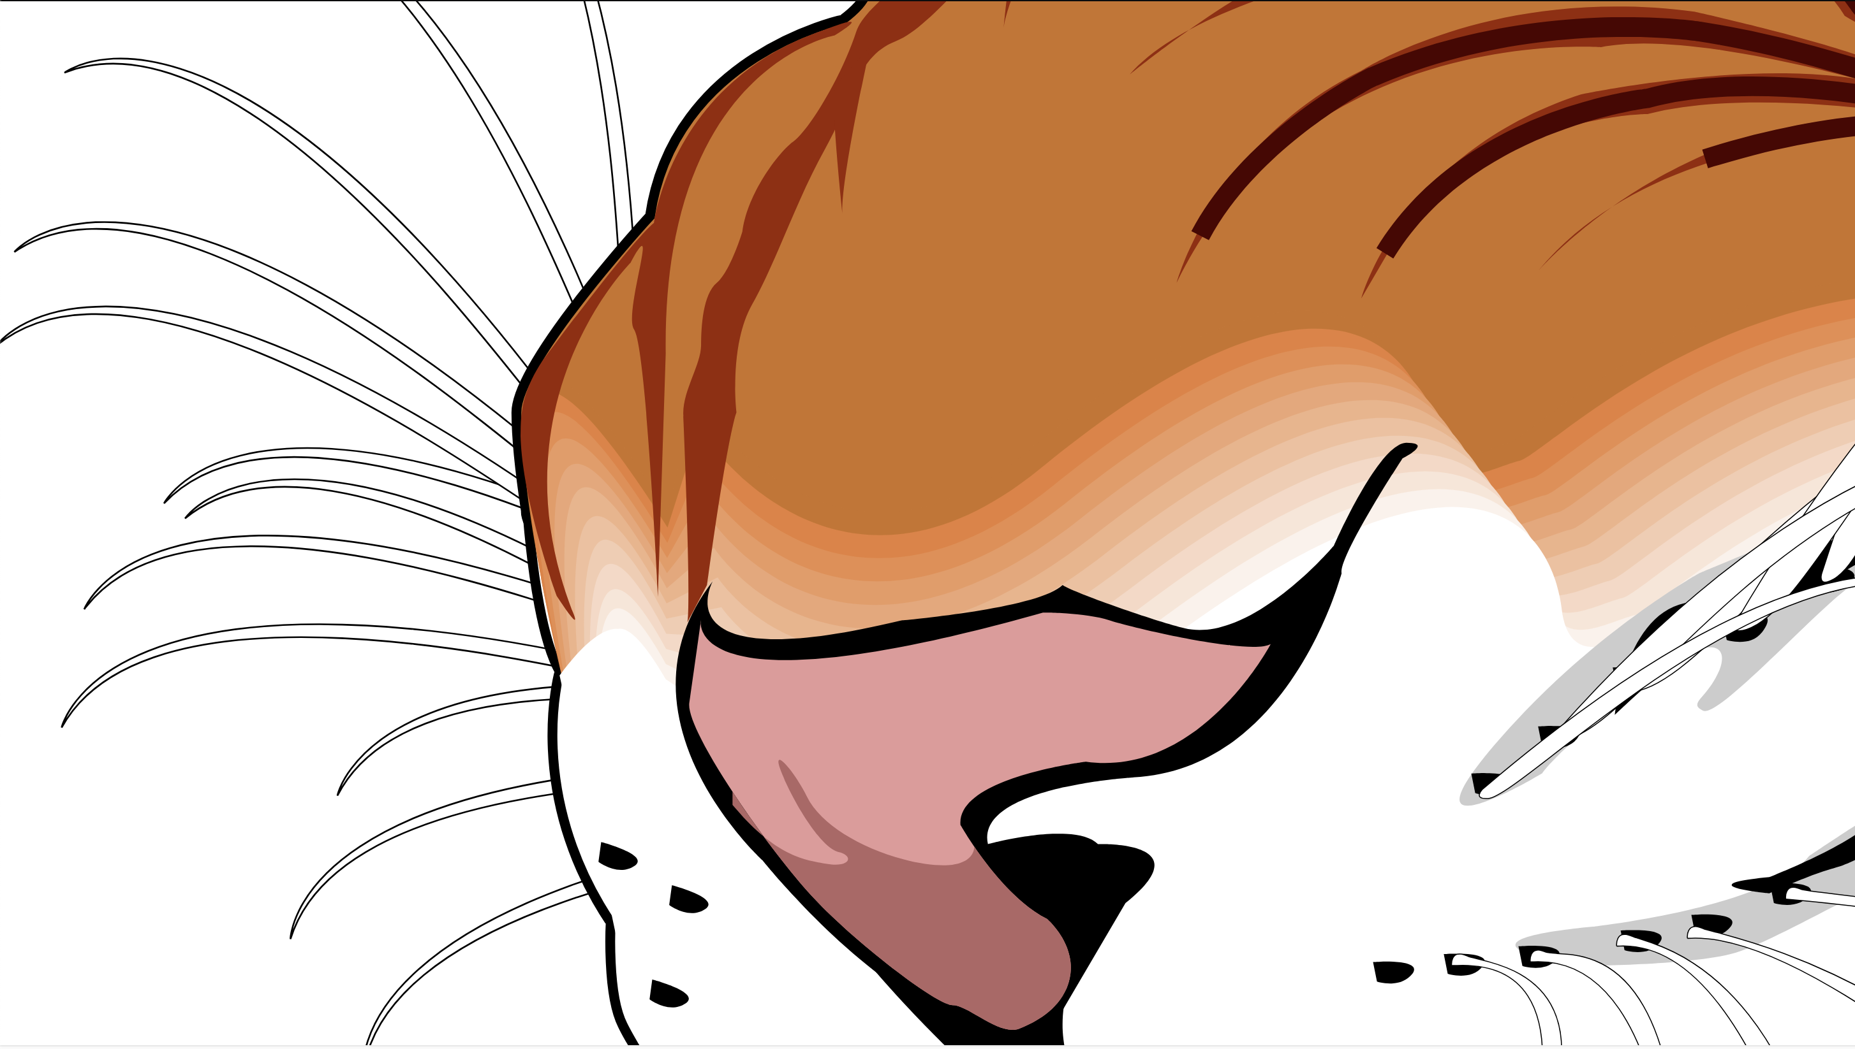
… but they have simplistic shading
Notes:
However, vector graphics are typically limited to rather simplistic shading as shown here.

Slide 22
Our goal
Notes:
In short, our goal is as follows

Slide 23
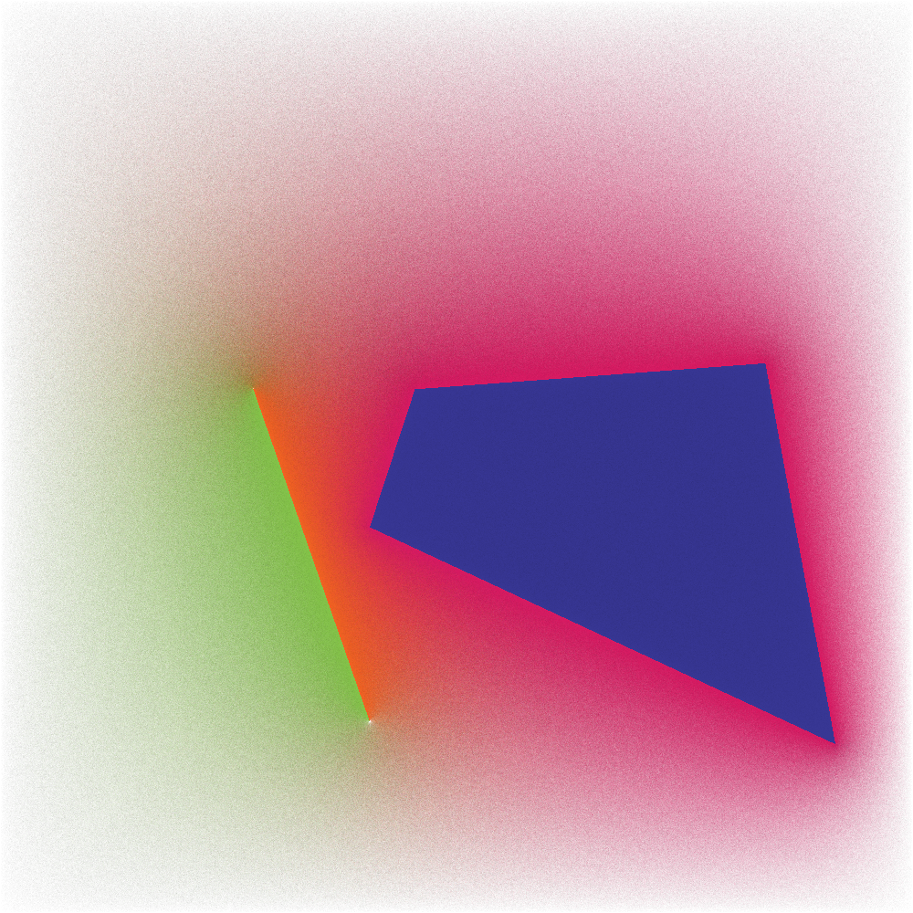
Our goal: encode a target image
Target image
Notes:
We want to encode a target image that could have an arbitrarily high resolution

Slide 24
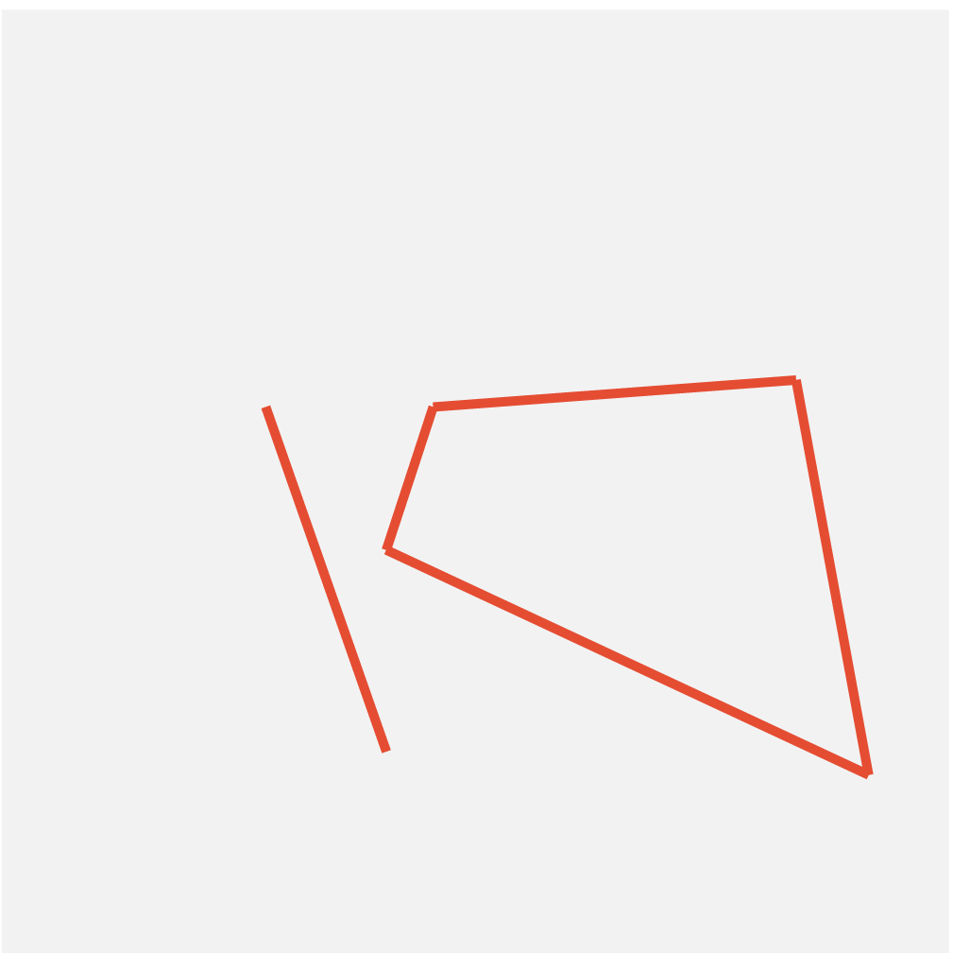
Our goal: encode a target image given its discontinuitiy locations
Target image
Discontinuity locations
Notes:
And we assume that we know the locations of its discontinuities.

Slide 25
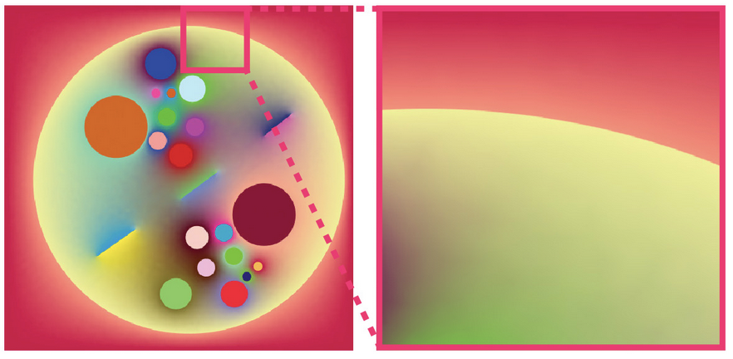
Curved discontinuities
Notes:
Our image format should also handle curved discontinuities. Unfortunately due to time constraints, I won’t have the chance to discuss it during this talk, please read our paper for more details.
At a high level we achieve our goal by building a neural field which employs an explicit feature field inspired by vector graphics.

Slide 26
Feature field construction
Notes:
Let’s first see how we construct our feature field

Slide 27
Feature field construction
Discontinuity locations
Notes:
Start with discontinuity locations

Slide 28
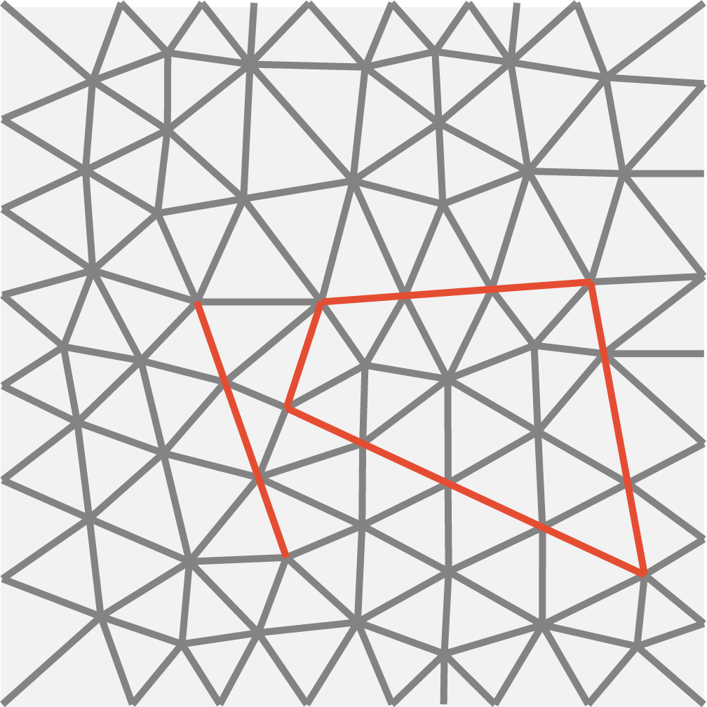
Feature field construction
Discontinuity locations
Triangulation
Hu 19: TriWild: Robust Triangulation with Curve Constraints
Notes:
Next we triangulate the domain in a way that respects discontinuities.
Notice how the discontinuities in the input show up as edges in the resulting triangulation.

Slide 29
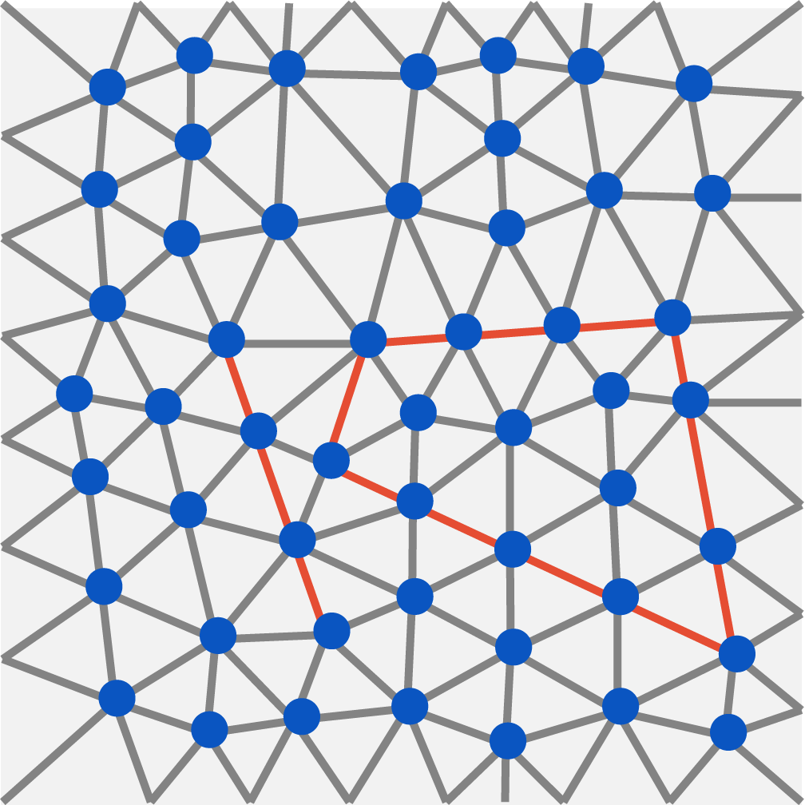
Feature field construction
Discontinuity locations
Triangulation
Feature field
Hu 19: TriWild: Robust Triangulation with Curve Constraints
Notes:
To turn this triangulation into a feature field, we associate features with the vertices of the triangulation.

Slide 30
Our feature field is aligned with discontinuities
Discontinuity locations
Triangulation
Feature field
Hu 19: TriWild: Robust Triangulation with Curve Constraints
Notes:
Let’s take a quick pause since this is a key idea of our paper.
Since we use of a constrained triangulation algorithm, our feature field has its edges aligned with the discontinuities provided as input.

Slide 31
Our rendering pipeline
Notes:
Let’s now see how our overall rendering pipeline works

Slide 32
Mapping queries to colors
Notes:
Once again, we start with our query point

Slide 33
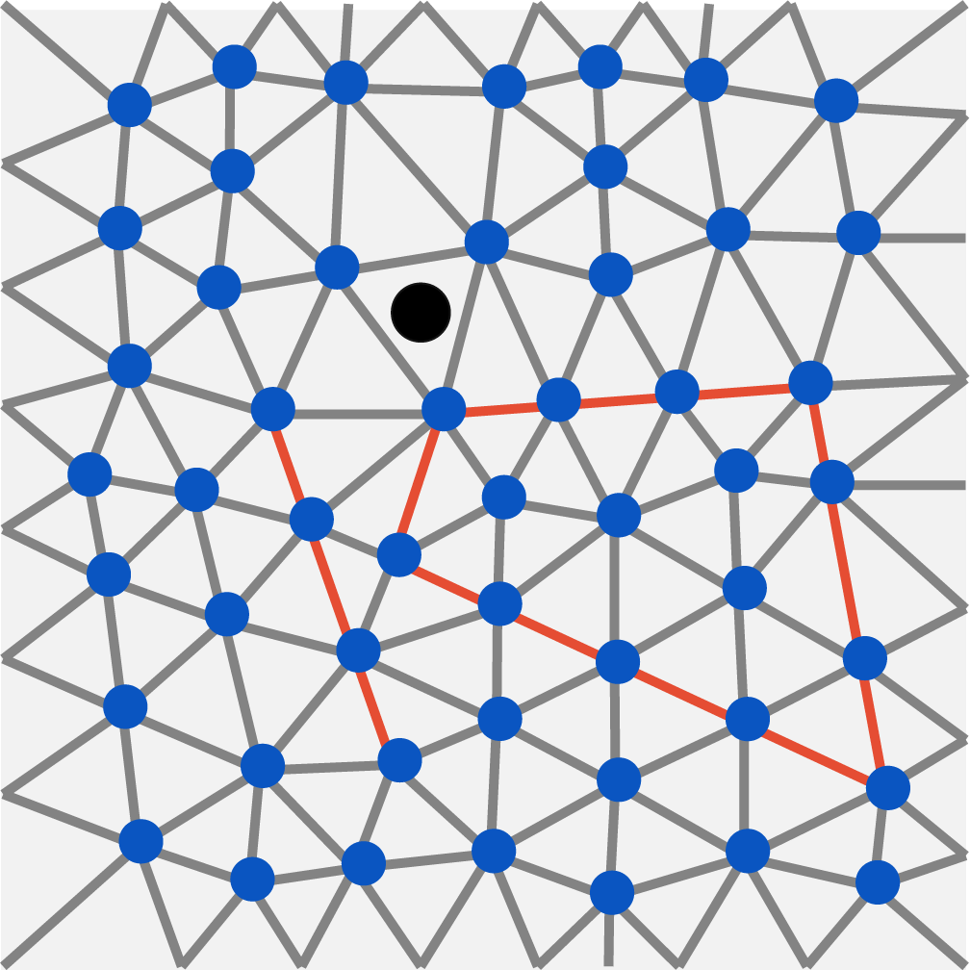
Mapping queries to colors
Feature field
Notes:
We find the triangle it belongs to

Slide 34
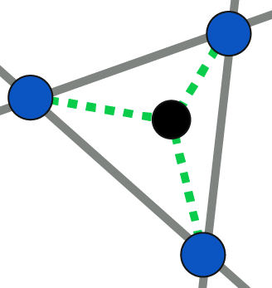
Mapping queries to colors
Feature field
Discontinuity-aware feature interpolation
Notes:
Next, we perform a discontinuity-aware feature interpolation.
It ensures that the feature field is discontinuous across the discontinuities shown in red.
We shall see how this works shortly.

Slide 35
Mapping queries to colors
Feature field
Interpolated Feature
Discontinuity-aware feature interpolation
Notes:
Once we have our interpolated feature,

Slide 36
Mapping queries to colors
Feature field
Interpolated Feature
MLP
Discontinuity-aware feature interpolation
Notes:
We map it through an MLP decoder

Slide 37
Mapping queries to colors
Feature field
Interpolated Feature
MLP
Color
Discontinuity-aware feature interpolation
Notes:
And this gives us our final color.
Because we used an interpolation scheme that is discontinuity-aware, the resulting feature field, and by extension, the predicted color is discontinuous.

Slide 38
Discontinuity-aware feature interpolation
Notes:
Now, let’s get to the really exciting bit, let’s talk about how our discontinuity-aware feature interpolation works.

Slide 39
Continuous vertex
Notes:
First, let’s start with a continuous vertex.
It’s connected to 5 edges, none of which are discontinuous.

Slide 40
Continuous vertex
Notes:
For it, we simply store a single feature for this vertex

Slide 41
Continuous vertex
Notes:
And for a given query point

Slide 42
Continuous vertex
Notes:
We simply use this feature

Slide 43
Discontinuous vertex
Notes:
But the story is a bit different for a discontinuous vertex, which is connected to one or more discontinuous edges.
Here, the vertex is connected to two discontinuous edges, shown in red.
Using a single feature for this vertex is insufficient to represent the different colors on the two sides of the discontinuity.

Slide 44
Different features above and below each discontinuity
Notes:
To fix this, at the discontinuous vertex, we store a pair of features for each discontinuous edge it is connected to.
These features are stored above and below each of the discontinuities respectively.

Slide 45
Evaluating vertex feature for a query point
Notes:
Let’s now see how we use the four features to retrieve the final vertex feature for a given query point.

Slide 46
Closest clockwise feature
Notes:
First we find the closest feature moving along the clockwise direction

Slide 47
Closest counter-clockwise feature
Notes:
Next, we find the closest feature by moving in the counter-clockwise direction.

Slide 48
Vertex feature = radially interpolate closest features
Notes:
To get the final vertex feature for this query point, we radially interpolate the two closest features we just found.

Slide 49
Closest features change on other side of discontinuity
Notes:
For a query point on the other side of the discontinuity

Slide 50
Closest features change on other side of discontinuity
Notes:
We have a different nearest clockwise feature

Slide 51
Closest features change on other side of discontinuity
Notes:
And a different nearest counter-clockwise feature

Slide 52
Closest features change on other side of discontinuity
Notes:
Since we select a different set of features for query points on the two sides of the discontinuity, our vertex features are discontinuous as our query point moves across the red discontinuities.

Slide 53
Putting it all together
Notes:
Let’s now put it all together to see the entire pipeline in action for a given query point.

Slide 54
Query point
Notes:
We start with a query point

Slide 55
Find triangle that contains query point
Notes:
Find the triangle it belongs to

Slide 56
Zooming in to query point
Notes:
Here’s a close up view of the triangle

Slide 57
Directly retrieve feature for continuous vertex
Notes:
First we retrieve the feature for the continuous vertex at the top

Slide 58
Retrieve features for discontinuous vertices
Notes:
Next, we retrieve the four features for the discontinuous vertex at the bottom left.

Slide 59
Find closest features
Notes:
We find the closest clockwise and counter-clockwise features

Slide 60
Radially interpolate closest features
Notes:
And radially interpolate them to get our second vertex feature for the query point.

Slide 61
Retrieve features for discontinuous vertices
Notes:
We do the same for the final vertex.

Slide 62
Find closest features
Notes:
We find the closest features

Slide 63
Radially interpolate nearest features
Notes:
Radially interpolate them

Slide 64
Barycentrically interpolate three vertex features
Notes:
now have all three vertex features for this query point.

Slide 65
Barycentrically interpolate three vertex features
Notes:
We barycentrically interpolate the three

Slide 66
Decode interpolated features using MLP
Interpolated feature
Notes:
And we now have the final interpolated feature for the query point

Slide 67
Decode interpolated features using MLP
Interpolated feature
MLP
Notes:
We decode it using an MLP

Slide 68
Decode interpolated features using MLP
Color
Interpolated feature
MLP
Notes:
And this gives us our final color

Slide 69
Recap
Feature field
Interpolated Feature
MLP
Color
Discontinuity-aware feature interpolation
Notes:
Just to recap, here’s what our overall pipeline looks like.
We have a feature field aligned with input discontinuity curves, we perform a discontinuity-aware feature interpolation and finally we decode the feature using an MLP.

Slide 70
Performance
Notes:
Now let’s talk about performance

Slide 71
60 FPS inference @1080p
60-120 FPS inference on our examples
Training is typically < 2 mins
All numbers are reported on an RTX 3090Ti
Notes:
Our method can do real time 60FPS inference at 1080p.
Training is quite fast too, typically under a couple of minutes.
We implement our pipeline in a combination of PyTorch and CUDA.

Slide 72
Results
Notes:
Finally, let’s get to the part you were all waiting for, the results.

Slide 73
Application: path-traced images
Notes:
Our first application is fitting path-traced images.

Slide 74
Application: path-traced image
Notes:
To find the discontinuities in this image, we extract the object silhouette edges and the geometric normal discontinuities in a preprocessing pass.
We optimize our representation to fit the path-traced image.
Let’s see what the final result looks like.

Slide 75
Notes:
Here, we’re going to see a zoom in sequence. The top left is the reference and the top right is ours. Competing methods are shown on the bottom row.
Zooming in, we can see that our method preserves sharp discontinuities at all zoom scales. Both ReLU fields and InstantNGP blur over the discontinuities.

Slide 76
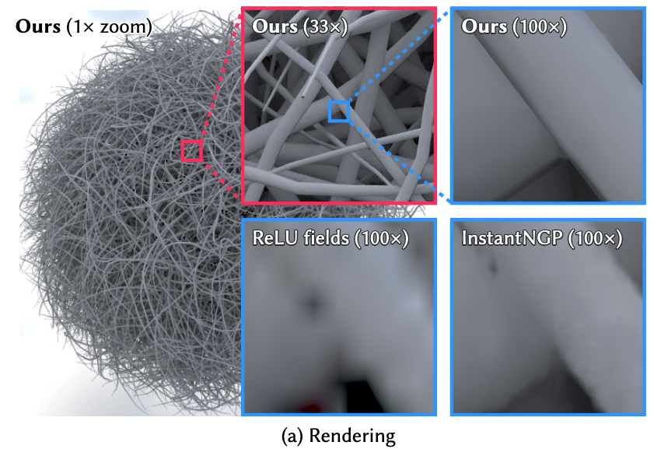
Application: path-traced image
Notes:
To showcase the extreme geometric complexity our method can handle, let’s look at the classic example of this hairball scene.
Even at 100x zoom, our method preserves sharp discontinuities while competing methods blur over the discontinuities

Slide 77
Application: diffusion curve images
Notes:
Our next application is fitting diffusion curve images

Slide 78
We start with some curves
Notes:
These images are defined by a set of discontinuity curves

Slide 79
Colors on both sides of curves
Notes:
And colors on either side of the discontinuities

Slide 80
Diffuse colors from curves
Notes:
By diffusing these colors outwards, we get the final diffusion curve image

Slide 81
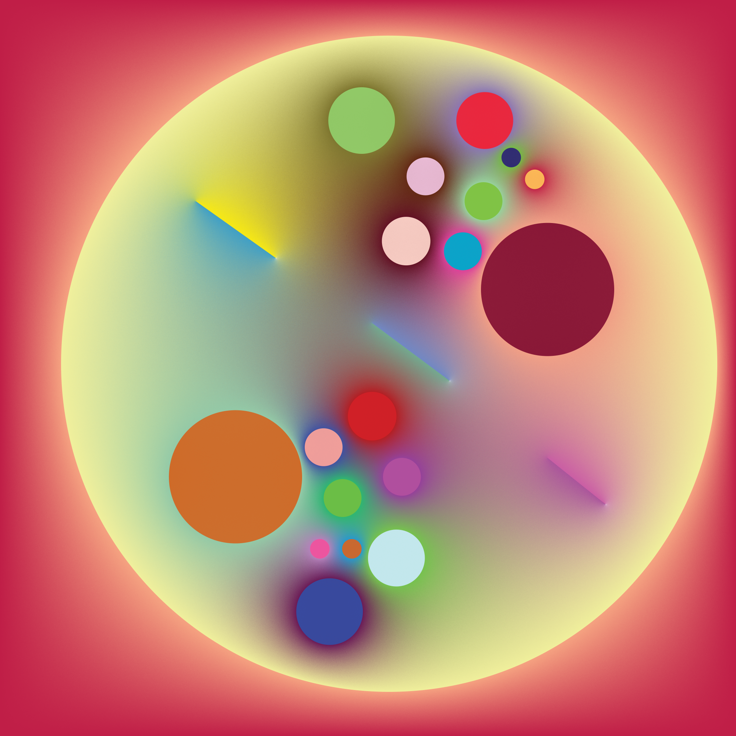
Diffusion curve image
Notes:
Here’s an example of a diffusion curve image

Slide 82
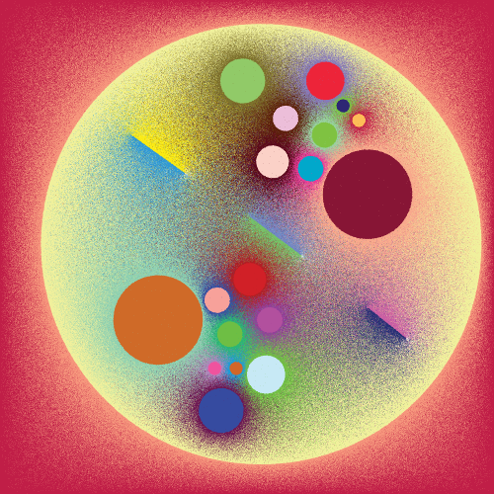
Monte Carlo estimate
Sawhney 20: Monte Carlo Geometry Processing
Notes:
This image can be estimated using Monte Carlo, which results in a noisy estimate.

Slide 83
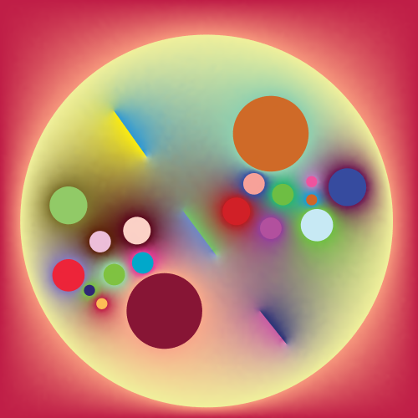
Monte Carlo data
Sawhney 20: Monte Carlo Geometry Processing
Ours
Notes:
Our method can denoise this noisy data effectively.

Slide 84
Monte Carlo data
Sawhney 20: Monte Carlo Geometry Processing
Ours
InstantNGP
Muller 22: Instant Neural Graphics Primitives with a Multiresolution Hash Encoding
Notes:
Competing methods overfit to the noise and blur discontinuities.

Slide 85
Our result: curved discontinuities
Notes:
Our method also supports curved discontinuities

Slide 86
Our result: open edges
Notes:
And edges with open endpoints.

Slide 87
Application: physics-informed diffusion curve
Notes:
For our next application, let’s look at a class of neural networks that directly solve partial differential equation instead of fitting a precomputed solution.
These are called physics informed neural networks and we use them to fit diffusion curves.

Slide 88
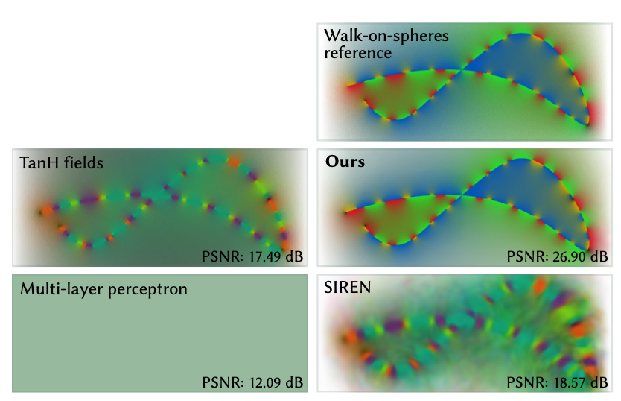
Application: physics informed diffusion curves
Notes:
Here’s the reference solution to the diffusion curve.

Slide 89
Application: physics informed diffusion curves
Notes:
Our method is able to produce a qualitatively similar looking solution.

Slide 90
Application: physics informed diffusion curves
Notes:
All competing methods cannot handle the discontinuous color variation and blur across the discontinuity. In this case, this produces a solution that does not look similar to the reference.

Slide 91
Application: store FEM solutions
Notes:
Our final application is fitting discontinuous solutions to partial differential equation produced by the finite element method.

Slide 92
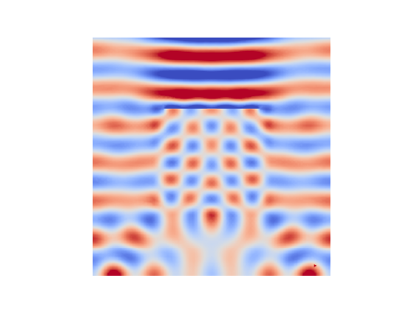
Application: store solution to Helmholtz equation
Notes:
We can fit the solution to the Helmholtz equation.

Slide 93
Application: store solution to wave equation
Notes:
By adding a time coordinate to our neural field, we can also fit the wave equation.

Slide 94
Limitations
We require discontinuity locations
Different data structure needed for high frequency continuous variation
Notes:
Our method isn’t without limitations.
To go beyond applications such as path-tracing, diffusion curve images, and others which have analytically known discontinuity locations, we need algorithms that can accurately detect discontinuities.
Our method doesn’t handle high frequency continuous variation out of the box, it will likely need to be paired with a different data structure to fix this issue.

Slide 95
Converting an image to pixels requires choosing a resolution and throwing away information beyond that resolution… When you really think about it, representing an image as pixels is really a bad compression technique… we need better image atoms…
Jim Blinn’s Corner Notation Notation Notation
yashbelhe.github.io
Code available!
Notes:
Finally, I’d like to close with a quote from Jim Blinn.
Read quote.
We hope that the method you’ve just seen is just the first of many techniques to better represent images, and that hopefully pixel based images as a storage format, can finally go away.
Our code is available online at the QR code below.

